Slide 1

Relembrando conhecimentos
> React = Biblioteca JS
> NextJS = Framework
- File system routing
- Client e Server rendering
- Server Components, Client Components
- Componentes e otimização

Slide 2
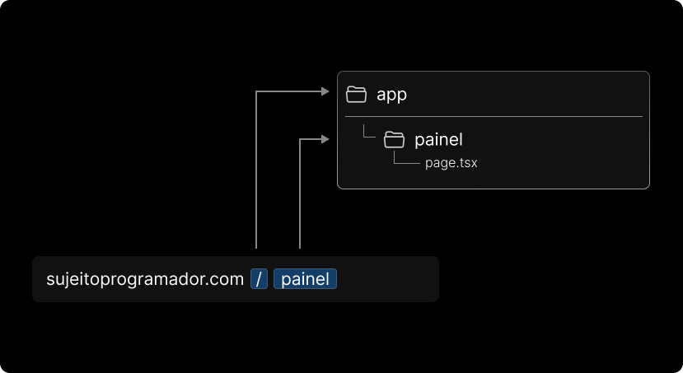
File system routing
( /pages e /app )
> app

Slide 3
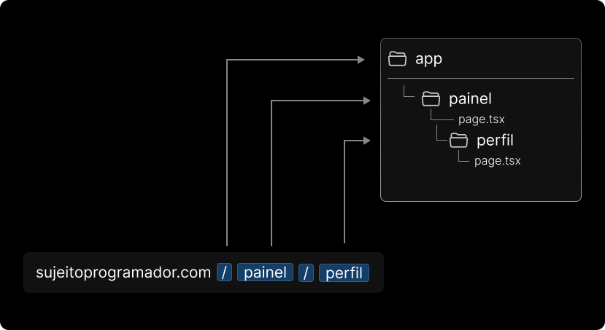
File system routing
( /pages e /app )
> app

Slide 4
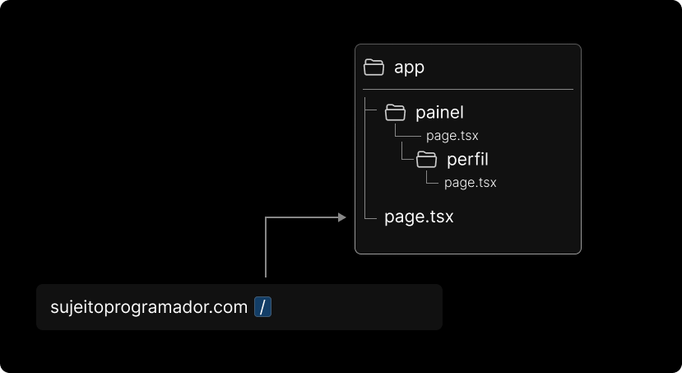
File system routing
( /pages e /app )
> app

Slide 5
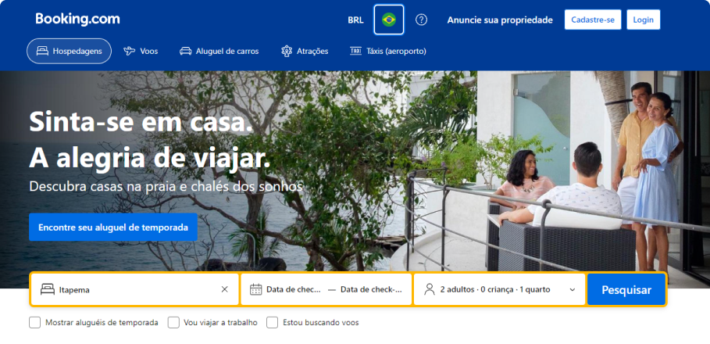
Client / Server Components
> app

Slide 6
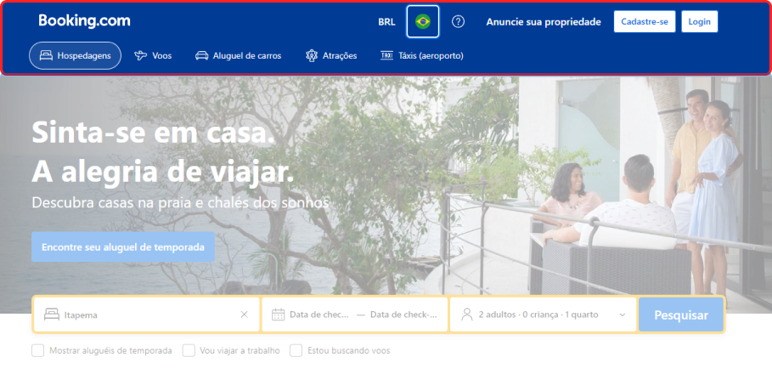
Client / Server Components
> app

Slide 7
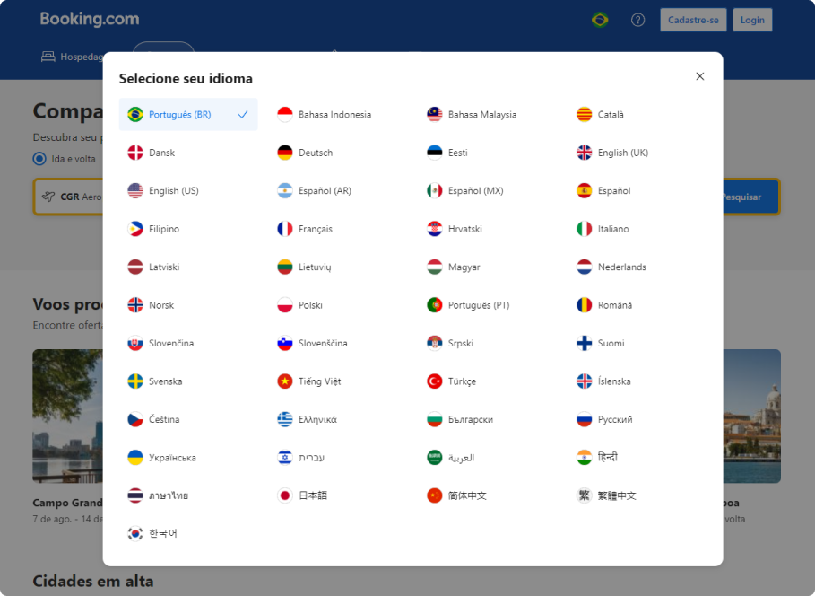
Client / Server Components
> app

Slide 8
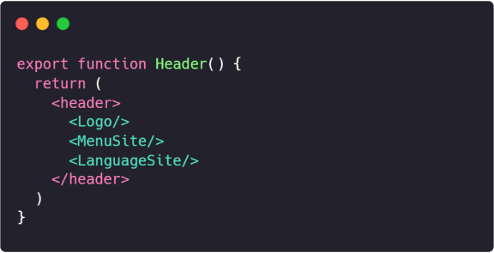
Client / Server Components
> app
Server component
Client component
Server component

Slide 9
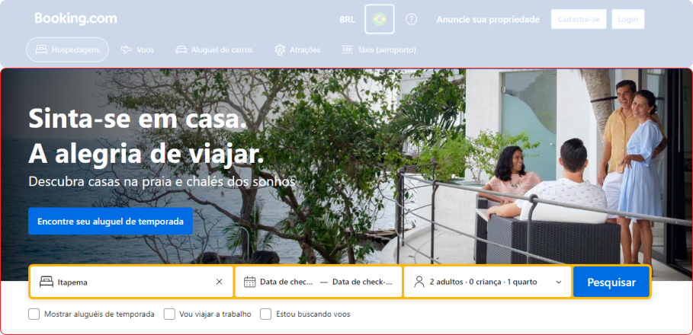
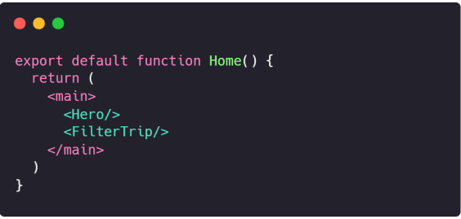
Client / Server Components
Server component
Client component

